Slide 1
ME469: Common Discretization Approaches: Control-volume Finite Element Method (CVFEM)
Stefan P. Domino^{1,2}
¹ Computational Thermal and Fluid Mechanics, Sandia National Laboratories
² Institute for Computational and Mathematical Engineering, Stanford
SAND2018-4536 PE

Slide 2
Review: Implicit vs Explicit
Recall, forward-in-time and central-in-space derivatives: FT-CS NOT STABLE
And, backward-in-time and central-in-space derivatives: BT-CS STABLE, however, oscillatory at high Peclet numbers

Slide 3
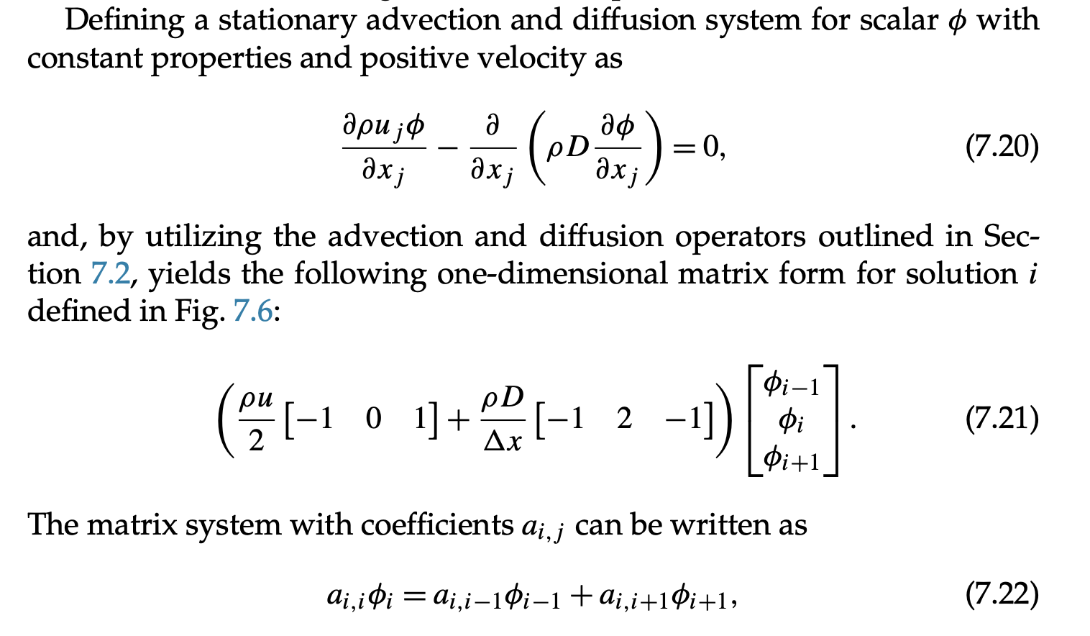
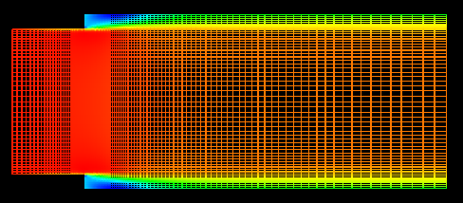
Matrix Assembly, Compact form
Each DOF location will have a
dedicated matrix “row” and set of
Columns defined by its connectivity

Slide 4
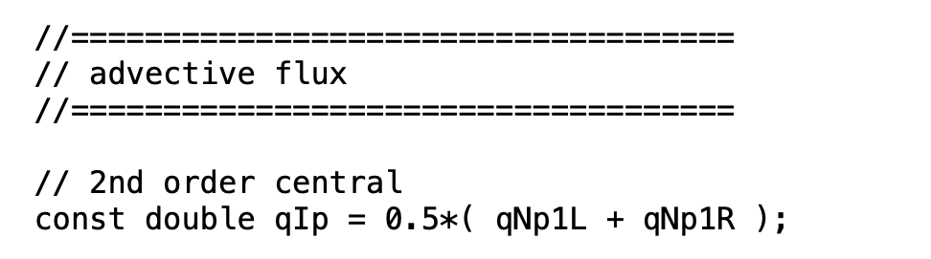
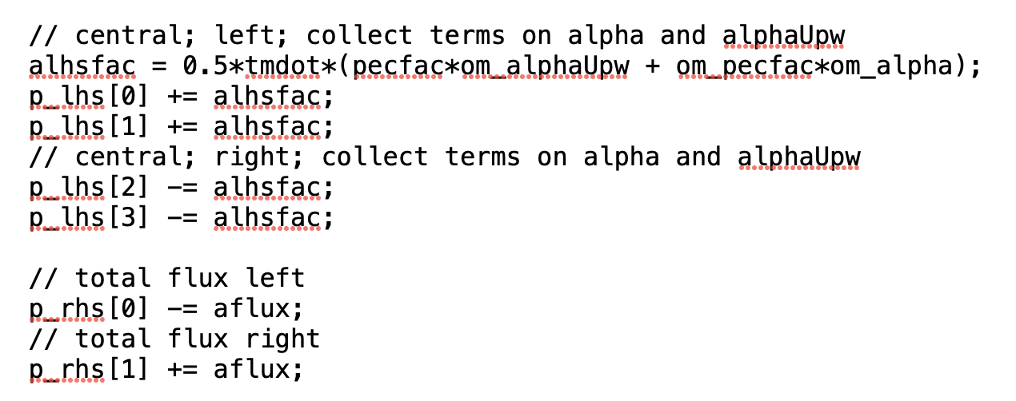
Matrix Assembly, Re-visited: Central Advection
https://github.com/NaluCFD/Nalu/blob/master/src/AssembleScalarEdgeSolverAlgorithm.C

Slide 5
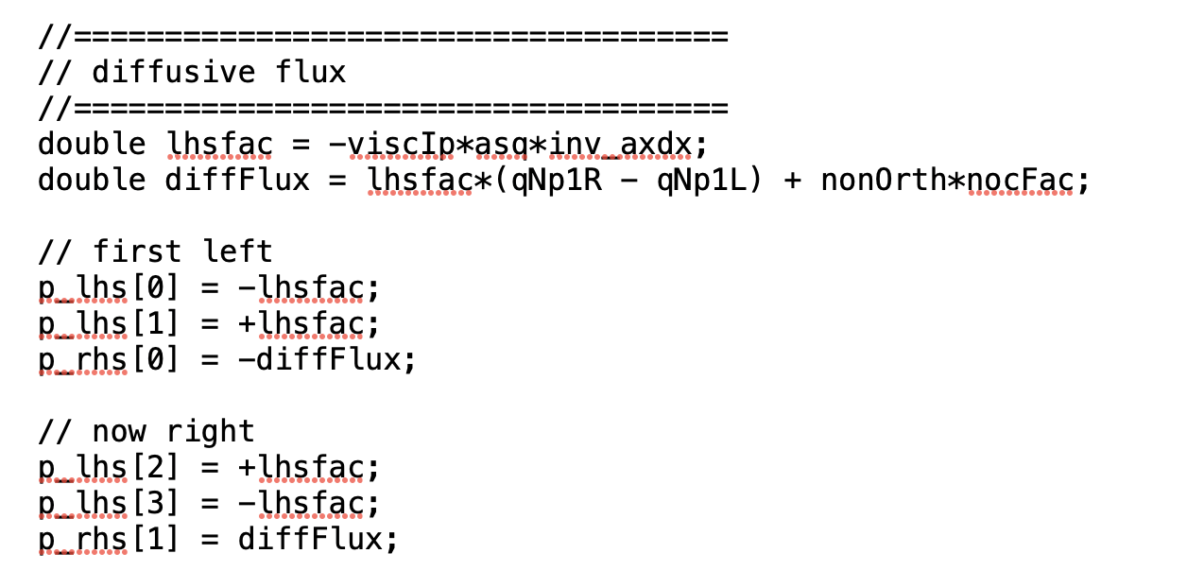
Matrix Assembly, Re-visited: Diffusion
https://github.com/NaluCFD/Nalu/blob/master/src/AssembleScalarEdgeDiffSolverAlgorithm.C

Slide 6
Recall, Stabilization Approach: Central + Diffusion = Proxy for Upwind (Derivation)
The FT-BS scheme is equivalent to:
and results in the modified equation:
State n or n+1
Central/Galerkin
Upwind (left to right velocity)

Slide 7
Review of Discretization Options: New, a nodal-basis over full domain (now focused on elements)…
Degree-of-freedom (DOF) for:
Cell-centered: Stencil is based on a element:face:element
DOFs at vertices of elements, or “nodes”, element:node (CVFEM, FEM), edge:node (EBVC)
Definition of an interpolation function:
is the Lagrange function associated with node n
is the value of the DOF at node n
The nodal basis functions obey equipartition of unity and satisfy,

Slide 8
Fundamentals of Discretization: Surface vs Volume Integrations
Given a partial differential equation (PDE) and associated volumetric form:
Applying Gauss Divergence provides the standard finite volume form for fluxes in surface integral form (no distinction between internal control volume faces and boundary faces):
We can also multiple PDE by an arbitrary test function, w, and integrate over a volume,
Next, integrate by parts and apply
Gauss-Divergence. Note, that test function must be differentiable – shown here, at least once..
Interior
Boundary

Slide 9
Edge-Based Vertex-Centered Leverages the Dual-Volume Element-based Description of a Control Volume Finite Element Method (CVFEM)
EBVC (A) and CVFEM (B) – As shown below, the dual-volume and integration point layout is very similar
(A)
(B)

Slide 10
Edge-Based Vertex-Centered Leverages the Dual-Volume Element-based Description of a Control Volume Finite Element Method (CVFEM)
EBVC (A) and CVFEM (B) – As shown below, the dual-volume and integration point layout is very similar
Volume integration
point (single vs multiple)
(A)
(B)

Slide 11
Edge-Based Vertex-Centered Leverages the Dual-Volume Element-based Description of a Control Volume Finite Element Method (CVFEM)
EBVC (A) and CVFEM (B) – As shown below, the dual-volume and integration point layout is very similar
Surface integration
point (single vs multiple)
(A)
(B)

Slide 12
Deep Dive on CVFEM
CVFEM is a discretization scheme that:
Iterates over locally-owned elements for Time/Source/etc. (volumetric-based terms)
Iterates over locally-owned elements for Advection/Diffusion/etc. (integrated by parts terms)
Below is the patch of elements connected to node 2 (a global matrix row number)
A dual-volume is defined within each element
8
5
6
Any value of the DOF within the element can be computed based on:
1
2
3
7
4
Sample patch of elements

Slide 13
The Control Volume for EBVC is Defined by the Dual-Volume
All primitives are collocated at the vertices of the elements with equal-order interpolation
A dual mesh is constructed to obtain flux and volume quadrature locations
Classic two-state, “L” and “R” approach provides spatially second-order accuracy
Iterate Nodes for volume-based contributions
Iterate Edges for surface-based contributions
Dual nodal volume
Area vector
T_{L}
n_{j}
T_{R}
Dual-volume definition
Edge-based stencil

Slide 14
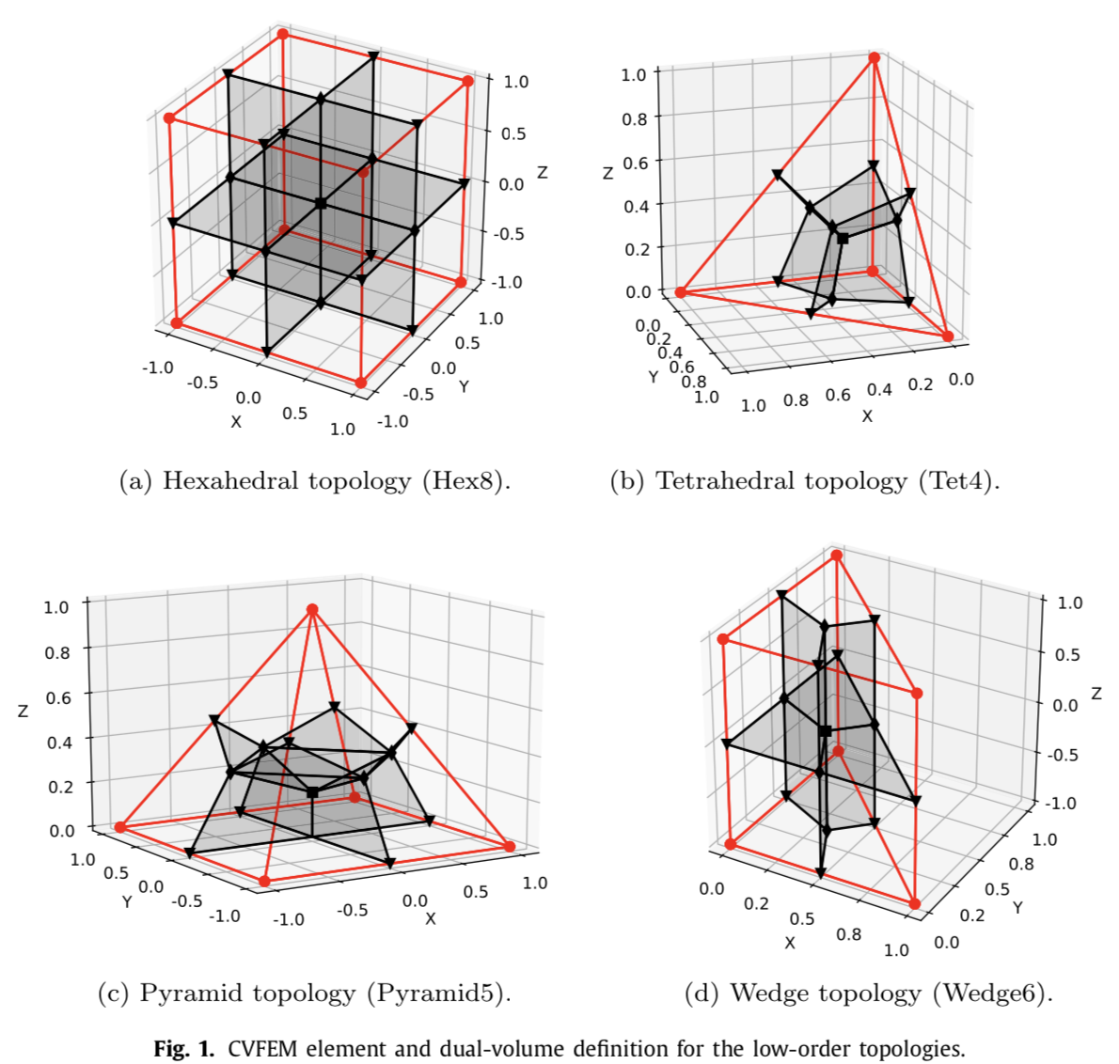
Dual Volume Definitions for Hybrid (Hex/Tet/Pyramid/Wedge) Meshes
Domino, et. al, “An assessment of atypical mesh topologies for low-Mach large-eddy simulation” 2019
Generalized unstructured meshes support the ability to capture complex geometries, while minimizing the meshing time
For example, near a solid wall, you might have a near-structured Hex-based mesh that is transitioned to unstructured
For the mesh to be conformal, the faces for each adjacent element topology should match
Drives Hex8 (Quad4 face) : Pyramid5 (Quad4 face); Pyramid5 (Tri3 face) to Tet4 (Tri3 face)
The Pyramid is known as a transition element

Slide 15
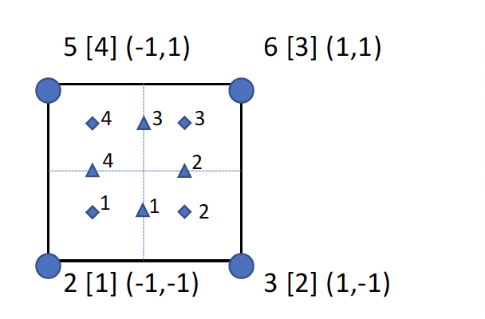
Deep Dive on CVFEM: Element-loops with Rich Basis
For each element, recall that a dual volume has been constructed
Volume-based contributions are evaluated at the sub-control volume integration points (diamonds)
Surface-based contributions are evaluated at the sub-control surface integration points (triangles)
We define an isoparametric element than ranges from -1:1 in the ξ− (x-direction) and η− (y-direction) direction
Basis Functions for a Quad4
Bar3 (quadratic)
η
ξ
For example, the isoparametric coordinate for ip 1 is (0.0, -0.5)

Slide 16
Deep Dive on CVFEM: Implicit Time Discretization
Backward Euler (two state) and is first-order accurate (A-stable)
BDF2 (three state) is second-order accurate (A-stable)
This term is assembled over an element iteration and drives a consistent mass matrix with a full node:element:node connectivity
For uniform time stepping, the coefficients are give by,
γ₁ = 3/2 γ₂ = -2 γ₃ = ½
You can easily see how the underlying basis pulls in the full node:element_node stencil:

Slide 17
Deep Dive on CVFEM: Implicit Time Discretization; Code
https://github.com/NaluCFD/Nalu/blob/master/src/kernel/ScalarMassElemKernel.C

Slide 18
The Consistent Mass Matrix
When evaluating the volumetric contributions using the full stencil, this approach is known as a consistent mass matrix as compared to the previous lumped mass matrix that is supported by CC and EBVC
(Consistent)
(Lumped)
Convecting Taylor Vortex analytical solution; error computed at 1 second
Shown to be the
convergence rate,
2nd order

Slide 19
Deep Dive on CVFEM: Source Term Discretization
Source terms for CVFEM are also assembled over an element or nodal loop
In some cases, the source term can be complex, i.e., includes gradients, which drives either a nodal assembly of these quantities to the nodes (recall, the projected nodal gradient), or local evaluation using the shape function derivatives (see upcoming diffusion operator)

Slide 20
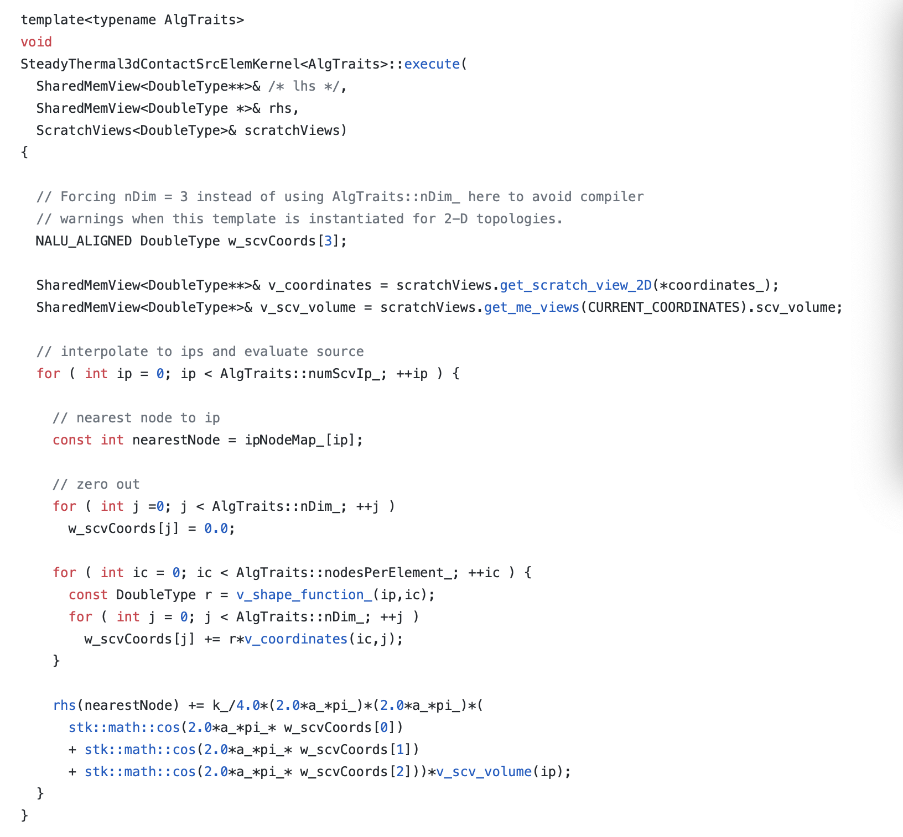
Deep Dive on CVFEM: Source Term Discretization; Code
https://github.com/NaluCFD/Nalu/blob/master/src/user_functions/SteadyThermal3dContactSrcElemKernel.C

Slide 21
Deep Dive on CVFEM: Advection Discretization (no stabilization)
For advection, we have transformed the volume integral to a surface integration
Therefore, a patch of elements are required for the full assembly at node 2
Recall, that the mass flow rate at an integration point is prescribed
Integration points can also be shifted from the sub-control surface to the edge midpoint (while still using the integration point area vector)
This is a central- or Galerkin-based advection operator
Notes:
Common to integrate-by-parts, however, not required
Advection term need not be in divergence form (non-conserved form is suitable)

Slide 22
Deep Dive on CVFEM: Advection Discretization Non-Conserved Form
The advection term can be integrated by parts, or not; moreover, the PDE can drive a non-conservative equation form:
Non-conserved form, unlike CC and EBVC, provides no added complexity

Slide 23
Deep Dive on CVFEM: Advection Discretization; Code
https://github.com/NaluCFD/Nalu/blob/master/src/kernel/ScalarAdvDiffElemKernel.C
This routine includes advection and diffusion
Recall that integration point value is provided by nodal loop over the underlying nodal basis for this element
Also note that this routine is valid for all types of supported elements – both low- and higher-order (polynomial promotion – coming later in the Quarter)

Slide 24
Deep Dive on CVFEM: Diffusion Discretization
For diffusion, we have transformed the volume integral to a surface integration
Therefore, a patch of elements are required for the full assembly at node 2
Note that the CVFEM approach is absent any non-orthogonality corrections;
However, high aspect ratio elements are now challenging…
Recall our underlying basis:

Slide 25
Deep Dive on CVFEM: Diffusion Discretization
For diffusion, we have transformed the volume integral to a surface integration
Therefore, a patch of elements are required for the full assembly at node 2
Note that the CVFEM approach is absent any non-orthogonality corrections;
However, high aspect ratio elements are now challenging…
Recall our underlying basis:
n2 (L)
n3 (R)
No non-orthogonality!
e2

Slide 26
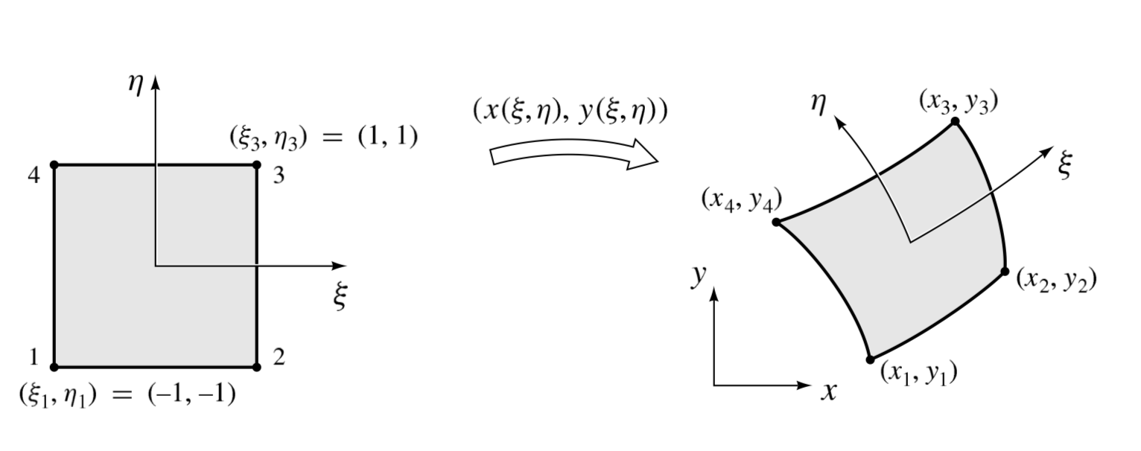
Deep Dive on CVFEM: Diffusion Discretization
For diffusion, we have transformed the volume integral to a surface integration
Therefore, a patch of elements are required for the full assembly at node 2
Note that the CVFEM approach is absent any non-orthogonality corrections;
However, high aspect ratio elements are now challenging…

Slide 27
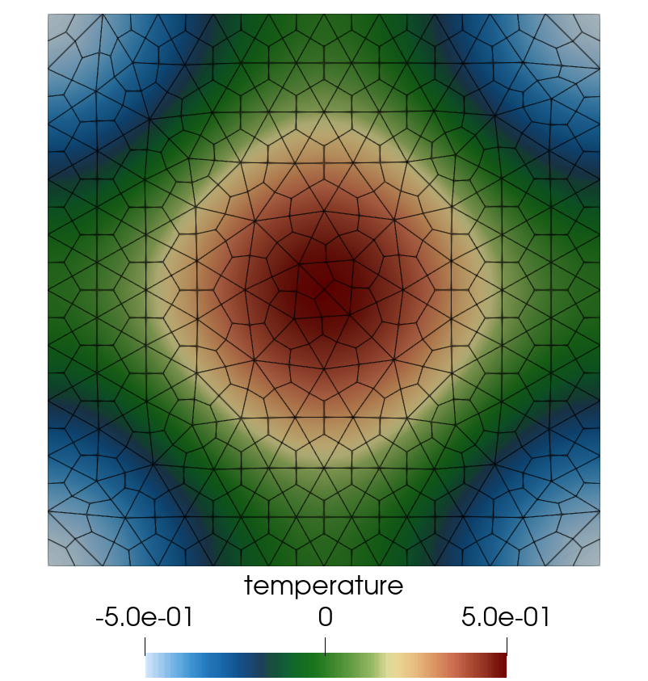
Deep Dive on CVFEM: Diffusion Discretization; Code
https://github.com/NaluCFD/Nalu/blob/master/src/kernel/ScalarAdvDiffElemKernel.C

Slide 28
A Note on Conservation
The CC, EBVC, and CVFEM all have one aspect in common………..
Specifically, a flux contribution is evaluated at the control volume face, and dotted with the area surface normal vector
This quantity, kg (stuff)/s, “leaves” control volume A, and fully enters control volume B and is conserved
For each integration point, the Left and Right nodal state is defined into which flux contributions are assembled
No loss of mass/momentum/energy/etc.
Surface integration
point (single vs multiple)
A
B

Slide 29
A Note on Polymorphism: Class Shape : Circle/Square/etc.
Recall, that the element type has been characterized by a set of unique attributes, take for example, a Hex8:
Nodes Per Element: 8
Number of surface integration points: 12
Number of volume integration points: 8
Number of Faces: 6
Face Topology: Quad4
Assembly Algoirthms can be templated, or expecting an integration rule defined by the element type
Pseudo C++
>Shape mySquare = new Square();
>Shape myCircle = new Circle();
>mySquare->volume();
>myCircle->volume();

Slide 30
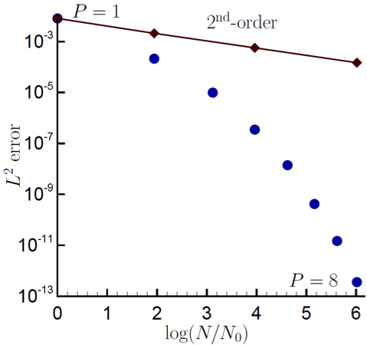
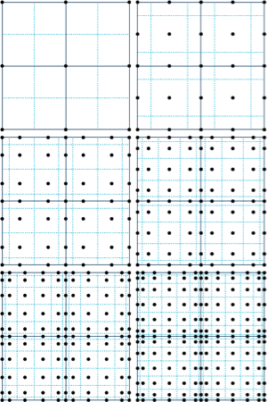

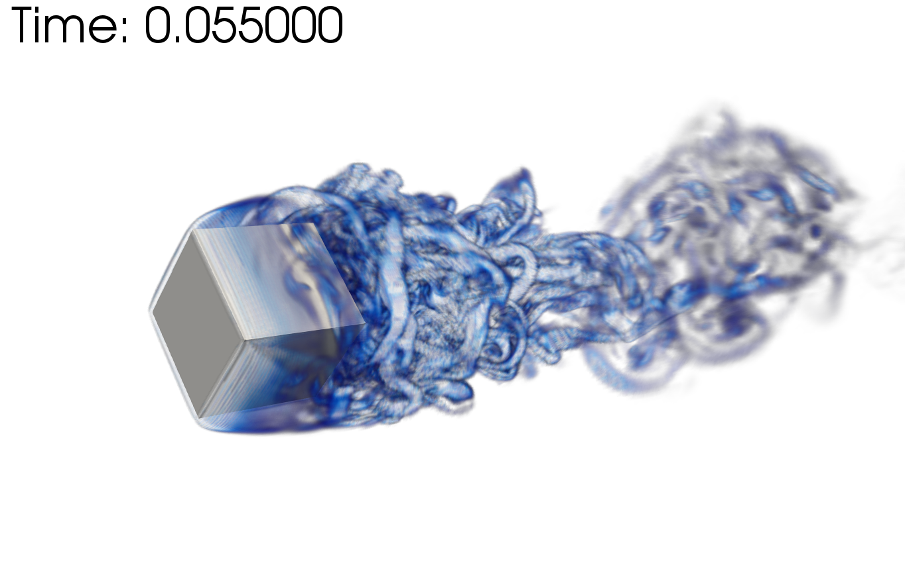
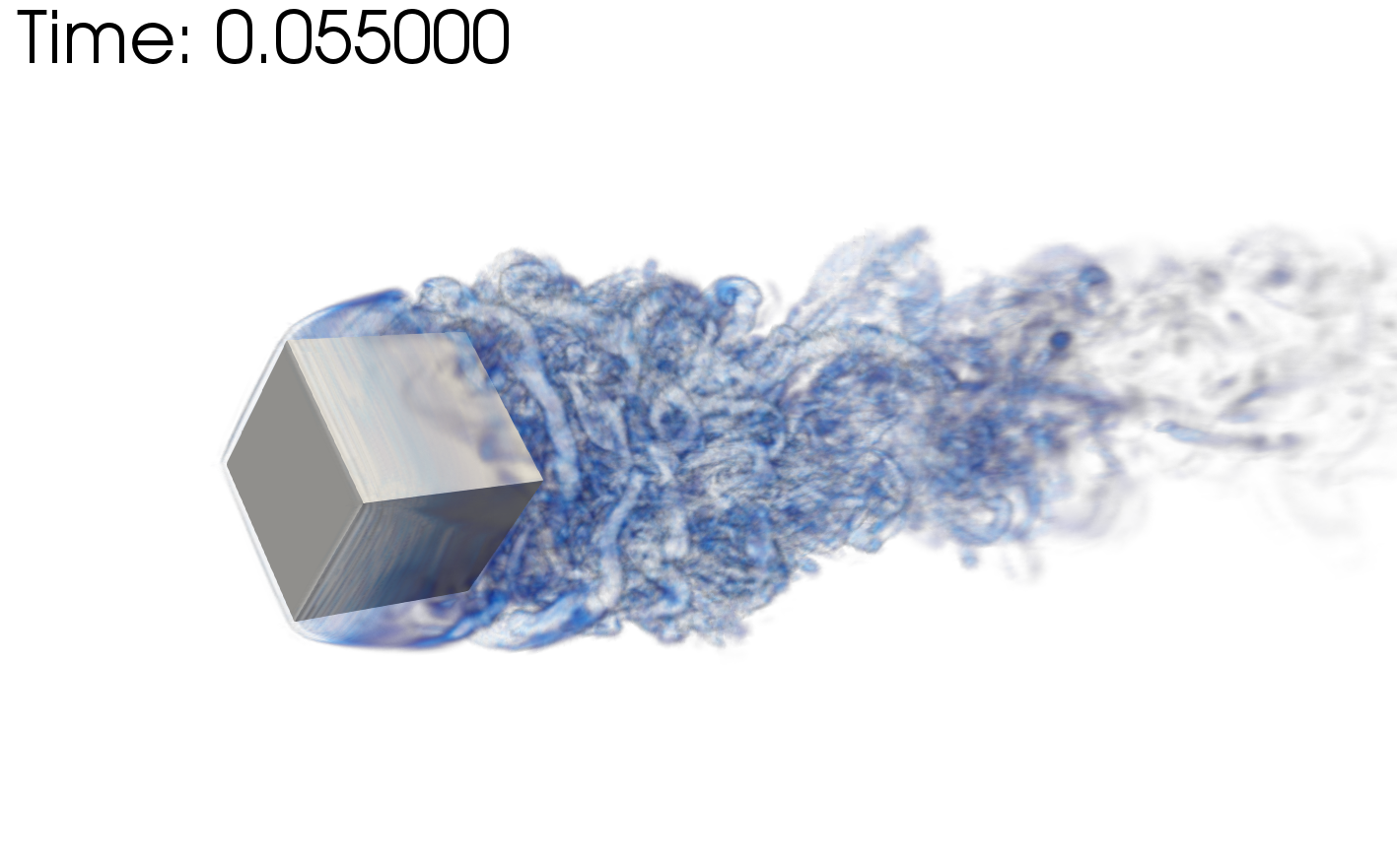
Higher-Order via Polynomial Promotion
CVFEM (like EBVC and CC) can be viewed as Petrov-Galerkin method
Recall how this is defined?
Basis can also be promoted (linear to quadratic, etc), i.e., Polynomial Promotion, Domino, CTRSP (2014) as a first example of low-Mach fluids algorithm – or Domino, JCP (2018)
Research Thrust: Possible higher efficiency on NGP due to increased local work)
However, suitability of higher-order for LES is an open argument – especially when other errors/uncertainties exist
Rotating cube (Re 4000, RPM 3600) P=1 (top) and P=2 (bottom)
Spectral convergence
Dual-volume for promoted quad4
P=1 (left) and P=4 (right)
Helium plume (VR-density)

Slide 31
CVFEM Review
Finite volume
Element-based
Hybrid between finite element method and finite volume
Underlying basis is tied to the element topology
Operators allow for consistent integration at subcontrol surfaces and subcontrol volumes
May be promoted in polynomial order
Some advantages of operators in the presence of non-orthogonality
Drives a more complex design in order to:
Manage multiple topologies, e.g., Hex, Tet, Wedge, Pyramid
Design computational kernels that can be re-used

